Slide 1
Data and AI Overview Chris Mitchell Rishi Arora

Slide 2
Advanced Analytics
How can we make it happen?
Prescriptive analytics
What will happen?
Predictive analytics
OPTIMIZATION
FORESIGHT
Why did it happen?
VALUE
Diagnostic analytics
What happened?
INSIGHT
Descriptive analytics
HINDSIGHT
INFORMATION
Traditional BI
Advanced analytics
Source: Gartner
DIFFICULTY

Slide 3
Here are some examples of how our customers are staying ahead
Improving visibility and making accurate predictions with remote monitoring
Getting the right products to the right places with inventory management
Offering customers exactly what they want, when they want it, with personalization
Fixing problems proactively before they start with predictive maintenance
Exploring new business opportunities with data-driven services
Notes:
Note: Data is the key component of all of these solutions. Data is needed to train predictive models and provide insights.

Slide 4



Cortana Intelligence Suite
Business apps
People
Custom apps
Apps
Sensors and devices
Cortana Intelligence
Automated systems
Data
Intelligence
Action
Notes:
When we talk about our Advanced Analytics offering it falls under the umbrella of the “Cortana Intelligence Suite”. Its important to note that CIS isn’t really a product but rather a collection of technologies that are likely deployed together to offer the solution. The important point here is data comes to us in a number of ways we gather that data and use it to derive business value.

Slide 5



Transform data into intelligent action
Information Management
Big Data Stores
Machine Learning and Analytics
Intelligence
People
Data Sources
Data Factory
Data Lake Store
Machine Learning
Cognitive Services
Data Catalog
SQL Data
Warehouse
Data Lake Analytics
Bot Framework
Web
Apps
HDInsight
(Hadoop and Spark)
Mobile
Event Hubs
Cosmos DB
Cortana
Apps
Bots
IOT Hubs
Dashboards & Visualizations
Sensors and devices
Stream Analytics
Automated Systems
Power BI
Data
Data
Intelligence
Action
Notes:
Here is the “map” of technologies in the suite, and we’ve bucketized them by the function they serve. Notice that these types of solutions data is born outside of the solution and consumed outside of the solution.

Slide 6

Information Management
Information Management
Data Sources
Data Factory
Apps
Data Catalog
Event Hubs
Sensors and devices
IOT Hubs
Data

Slide 7
Compose and orchestrate data services at scale
Information Management
SQL
Data Factory
INGEST
PREPARE
TRANSFORM & ANALYZE
PUBLISH
DATA SOURCES
SQL
SQL
DATA CONSUMPTION
<>
Data Catalog
Event Hubs
SQL
{ }
IOT Hubs
Create, schedule, orchestrate, and manage data pipelines
Visualize data lineage
Connect to on-premises and cloud data sources
Monitor data pipeline health
Automate cloud resource management
Move relational data for Hadoop processing
Transform with Hive, Pig, or custom code

Slide 8

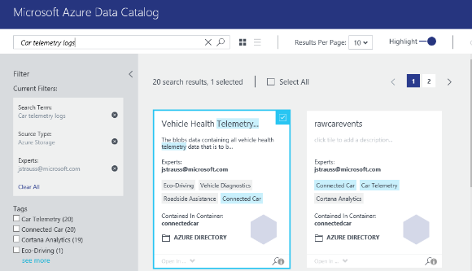
Get more value from your enterprise data assets
Information Management
Data Factory
Data Catalog
Event Hubs
IOT Hubs
Spend less time looking for data, and more time getting value from it
Register enterprise data sources, discover data assets and unlock their potential, and capture tribal knowledge to make data understandable
Bridge the gap between IT and the business, allowing everyone to contribute their insights, tags, and descriptions
Intuitive search and filtering to understand the data sources and their purpose
Let your data live where you want; connect using tools you choose
Integrate into existing tools and processes with open REST APIs

Slide 9
Ingest events from websites, apps and devices at cloud scale
Information Management
Data sources
SQL Database
Machine Learning
Data Factory
Apps
Azure
API
Management
Data Catalog
Storage
HDInsight
Sensors and devices
Event Hubs
Event Hubs
Backend Services
Stream Analytics
Power BI
IOT Hubs
Data
Log millions of events per second in near real time
Connect devices using flexible authorization and throttling
Use time-based event buffering
Get a managed service with elastic scale
Get a managed service with elastic scale
Reach a broad set of platforms using native client libraries
Pluggable adapters for other cloud services

Slide 10
Specialized Device Scenarios with IOT Suite
IoT Hub
Event processing and insight
(e.g. hot and cold paths)
1
0
1
1
0
0
1
1
0
0
0
1
1
0
1
0
1
0
1
0
0
1
1
0
Information Management
IP-capable
0
1
1
0
1
0
Cloud protocol
gateway
0
1
1
1
Data Factory
Field gateway
Device business logic,
Connectivity monitoring
PAN-devices
Data Catalog
Application
device provisioning and management
Event Hubs
IOT Hubs
Data
field
cloud
Support for multiple protocols (AMQP, MQTT)
Bi-directional communication
Device specific secuirty
Multi-platform gateway SDK.

Slide 11
Information Management Futures

Slide 12


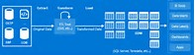
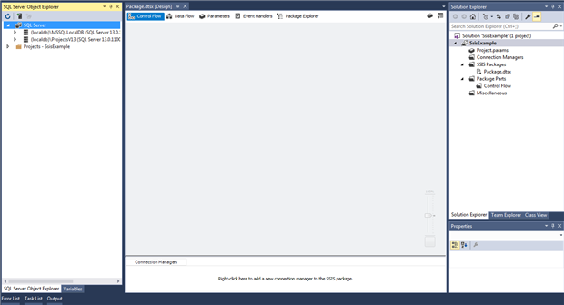
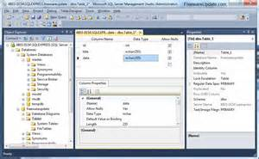
ETL/ELT Services in Azure (In Preview)
Value prop – What’s new​
Fully managed ETL/ELT service​
Over 40 source connectors​
Extensive control flow capabilities​
Intuitive UI for rich data flow (coming soon)​
SSIS provisioning in cloud​
Capabilities​
Lift your SSIS workload to the cloud​
Modernize your DW at reduced cost and increased scalability​
Deploy ETL/ELT on self-hosted environment​
Build truly intelligent experience with data-driven SAAS applications​
ISVs
ML
HDI
Provision
SSIS Everest on ADF compute resource
Cloud
ADF (PROVISIONING)
On-Premises
Execute/Manage
Author/Deploy
SSDT
SSIS Server
SSMS
Author/Deploy
Execute/Manage
Notes:
"SQL Migrators": ~95% of them want SQL MI inside their VNet to maintain network isolation. To support them, we need to have both SSISDB hosted by SQL MI and SSIS compute resource inside the same VNet.
"ETL Cost Cutters": They don't necessarily want to migrate their SQL Servers to the cloud, in fact some of their sensitive data must stay on premises. Unlike cohort 1), they don't have strict VNet requirements and accept creating a new VNet to enable on-prem data access. Some of them even have just cloud<->cloud ETL scenarios that don't require VNet at all. To support them, we can have SSISDB hosted by SQL DB in the public network and SSIS compute resource optionally inside their VNet.

Slide 13

Azure IoT Edge (In Preview)
Container based modules
Azure Functions
Azure Stream Analytics
Azure Machine Learning
Cognitive Services
Offline / Synchronized Device Twins
Local Storage
Cloud Management & Deployment
High Availability / Fault Tolerance
Cloud Dev/Test Support
Azure IoT Edge
IoT Hub
Azure Machine Learning
(Container)
Azure Stream Analytics
(Container)
Azure Functions
(Container)
Cognitive Services
(Container)
Custom Code
(Container)
Devices
Module
Twin
Module
Twin
Module
Twin
Module
Twin
Module
Twin
Container
Management
Functions
Runtime
Local Storage
Device
Twin
Device
Twin
Module
Twin
Module
Twin
Module
Twin
Module
Twin
Module
Twin

Slide 14

Big Data Stores
Information Management
Big Data Stores
Data Sources
Data Factory
Data Lake Store
Apps
Data Catalog
SQL Data
Warehouse
Event Hubs
Cosmos DB
Sensors and devices
Data

Slide 15



A hyper-scale repository for big data analytics workloads
Big Data Stores
Devices
Social
ADL Analytics
Data Lake Store
LOB Applications
Video
HDInsight
ADL Store
SQL Data
Warehouse
R
Web
Sensors
Spark
Cosmos DB
Relational
Clickstream
Machine Learning
A Hadoop Distributed File System for the cloud
No fixed limits on file size
No fixed limits on account size
Unstructured and structured data in their native format
Massive throughput to increase analytic performance
High durability, availability, and reliability
Azure Active Directory access control

Slide 16
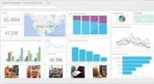
Elastic data warehouse as a service with enterprise-class features
Big Data Stores
Data Lake Store
Power BI
Hadoop
SQL Data
Warehouse
App Service
SQL Database
Cosmos DB
SQL Data Warehouse
Intelligent App
Machine Learning
Petabyte scale with massively parallel processing
Independent scaling of compute and storage—in seconds
Transact-SQL queries across relational and non-relational data
Full enterprise-class SQL Server experience
Works seamlessly with Power BI, Machine Learning, HDInsight, and Data Factory

Slide 17
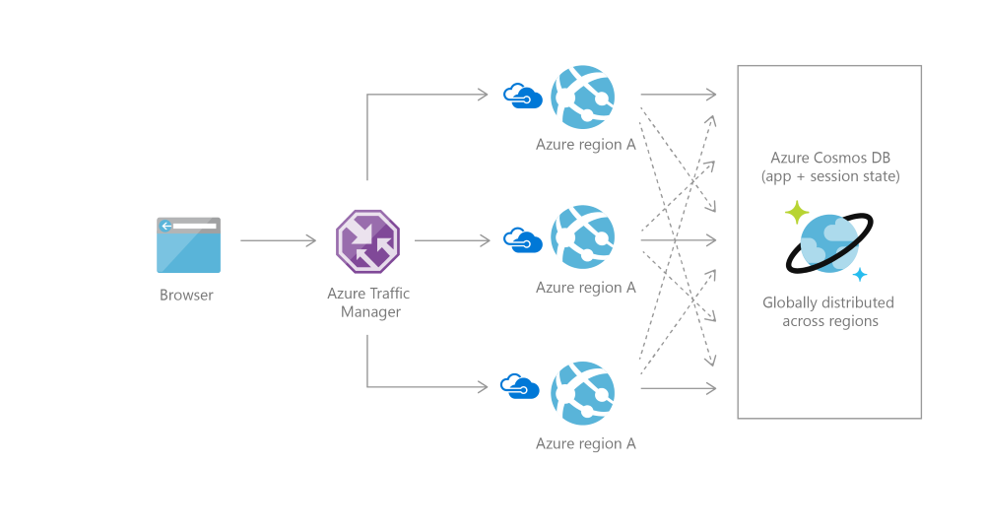
Globally distributed NoSQL Solution with multiple APIs
Big Data Stores
Data Lake Store
SQL Data
Warehouse
Cosmos DB
Globally Distributed
4 APIs today (SQL, Mongo, Table, & Graph)
Elastic Scale
Choice of consistency (5 levels of consistency)
Enterprise Grade SLA (99.95)
Guaranteed SLA (under 10ms for writes 5ms for reads)

Slide 18
Data Stores Futures

Slide 19
Overview of SQL DB Managed Instance
SQL Database (DBaaS)
Singleton
Elastic Pool
Managed Instance
A flavor of SQL DB that designed to provide easy app migration to a fully managed PaaS
Unmatched app compatibility
Unmatched PaaS capabilities
Favorable business model
Fully-fledged SQL instance with nearly 100% compat with on-prem
Learns and adapts with customer app
Competitive
Transparent
Frictionless
Notes:
Customers who want to take advantage of Azure “cloud economy” but have apps with complex platform/environment dependencies:
Easily move apps to PaaS, safely and without friction​
Leverage PaaS benefits immediately
Grow in a cost-effective way​
Move applications back to on premise if needed​
CL Series - New SQL DB offering designed to simplify Azure migrations for complex on-prem applications
Managed SQL Server instance with full PaaS capabilities​
Support for VPN​
Near 100% surface area compatibility with SQL Server on-premise​
Flexible scaling options that enable cost-effective growth on PaaS​

Slide 20
Azure Database Migration Service
SQL DB
Streamline database migration to Azure
Managed service platform for migrating databases
Migrate SQL Server & 3rd party databases to Azure SQL Database
Oracle
SQL
Accelerating your journey to the cloud
Notes:
As organizations look to optimize their IT infrastructure so they have more time and resources to focus on business transformation, Microsoft is committed to accelerating these initiatives. Microsoft announced that a new migration service is coming to Azure to streamline customers’ journey to the cloud. This service will streamline the tasks required to move existing competitive and SQL Server databases to Azure. Deployment options will include Azure SQL Database and SQL Server in Azure VM.
Managed service platform for migrating databases
Azure SQL DB and Managed Instance as targets
Competitive DBs – Oracle and more
Meets enterprise non-functional requirements (NFRs) – Compliance, Security, Costs, etc.
TALK ACOUT THE TECHNICAL DETAILS:
Source ->Target.
Secure.
Feature Parity with competitors.
Zero data loss and near zero downtime migration Azure platform service.

Slide 21
Machine Learning and Analytics
Information Management
Big Data Stores
Machine Learning and Analytics
Data Sources
Data Lake Store
Machine Learning
Data Factory
SQL Data
Warehouse
Data Lake Analytics
Apps
Data Catalog
Cosmos DB
HDInsight
(Hadoop and Spark)
Event Hubs
Sensors and devices
IOT Hubs
Stream Analytics
Data
Intelligence

Slide 22



Big data analytics made easy
Machine Learning and Analytics
Machine Learning
Data Lake Analytics
Data Lake Analytics
HDInsight
(Hadoop and Spark)
SQL DW
SQL DB
Data Lake Store
Storage Blobs
SQL DB in a VM
Stream Analytics
Analyze data of any kind and size
Develop faster, debug and optimize smarter
Interactively explore patterns in your data
No learning curve—use U-SQL, Spark, Hive, HBase and Storm
Managed and supported with an enterprise-grade SLA
Dynamically scales to match your business priorities
Enterprise-grade security with Azure Active Directory
Built on YARN, designed for the cloud

Slide 23
Comprehensive set of managed Apache big data projects
Machine Learning and Analytics
Batch
Map Reduce
Script
Pig
SQL
Hive
NoSQL
HBase
Streaming
Storm
In-Memory
Spark
Machine Learning
Data Lake Analytics
HDInsight
(Hadoop and Spark)
Core Engine
Stream Analytics
Scale to petabytes on demand
Process unstructured and semi-structured data
Develop in Java, .NET, and more
Skip buying and maintaining hardware
Deploy in Windows or Linux
Spin up an Apache Hadoop cluster in minutes
Visualize your Hadoop data in Excel
Easily integrate on-premises Hadoop clusters

Slide 24
Real-time stream processing in the cloud
Machine Learning and Analytics
SQL Database
Machine Learning
Event Hubs
Blob Storage
Event Hubs
Data Lake Analytics
Stream Analytics
Table Storage
HDInsight
(Hadoop and Spark)
Blob Storage
Power BI
Stream Analytics
Perform real-time analytics for your Internet of Things solutions
Stream millions of events per second
Get mission-critical reliability and performance with predictable results
Create real-time dashboards and alerts over data from devices and applications
Correlate across multiple streams of data
Use familiar SQL-based language for rapid development

Slide 25
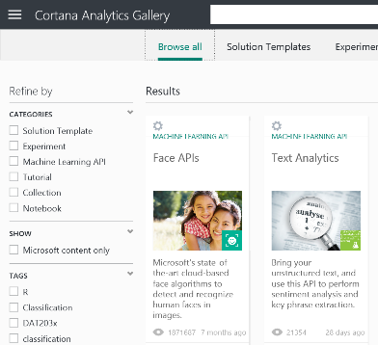
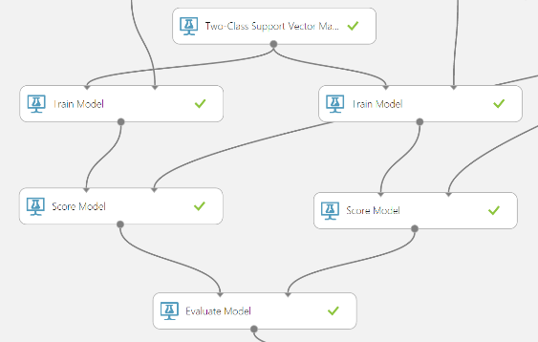
Easily build, deploy, and share predictive analytics solutions
Machine Learning and Analytics
Machine Learning
Data Lake Analytics
HDInsight
(Hadoop and Spark)
Stream Analytics
Simple, scalable, cutting edge. A fully managed cloud service that enables you to easily build, deploy, and share predictive analytics solutions.
Deploy in minutes. Azure Machine Learning means business. You can deploy your model into production as a web service that can be called from any device, anywhere and that can use any data source.
Publish, share, monetize. Share your solution with the world in the Gallery or on the Azure Marketplace.

Slide 26
Machine Learning and Analytics Futures

Slide 27
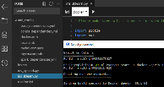
New capabilities coming to “Project Vienna”
Cloud
Vienna App
Services
4
2
HDInsight
VMs
Experimentation Service (Life cycle management, model metrics, run history)
Operationalization Service (Deployment, hosting, management, monitoring of models)
5
ACS
3
Azure Batch
On-Premises
1
Local compute
Data scientist
workstation
6
SQL Server
ML Server
Intelligent Data Prep
Agile Modeling
Freedom to use any IDE
Public Preview: 1, 2, 4
GA: 1,2,3,4,5,6
TBD: HDInsight
Desktop App
Edge
Train & Deploy
7
IoT Edge
Deploy

Slide 28
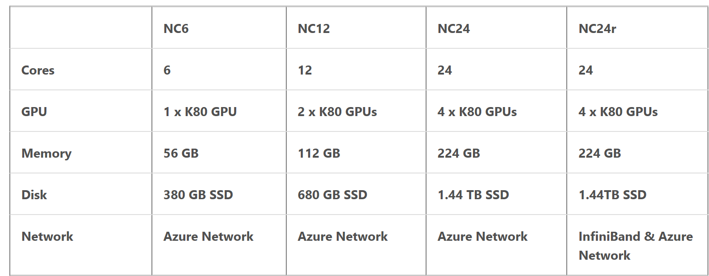
Artificial Intelligence Focus on Partners
The CEO of Box sees AI as “the most important technology trend since the cloud” – technology that he said “has the potential to completely change the way that we work.”
He added that “to leverage the strengths of AI and machine learning, technology providers need three key assets”: lots of data, the ability to use and learn from that data, and frequent activity to be able to train an organization’s systems at scale.
Sample of DSVM SKUs below:
Notes:
Using machine learning, the company can not only automate metadata creation, a task humans are notoriously bad at, it could then take advantage of that metadata to add intelligence across the entire platform
Under the new partnership, Box will use Microsoft Aonezure as a “strategic public cloud platform and Microsoft sales reps globally will co-sell and be compensated for selling Box offerings that use Azure,” The pact will also “enable future integrations between Azure’s artificial intelligence and machine learning capabilities with Box’s cloud content management platform, and will eventually expand Box Zones to additional countries, using Azure’s 40 data centers around the world,”

Slide 29
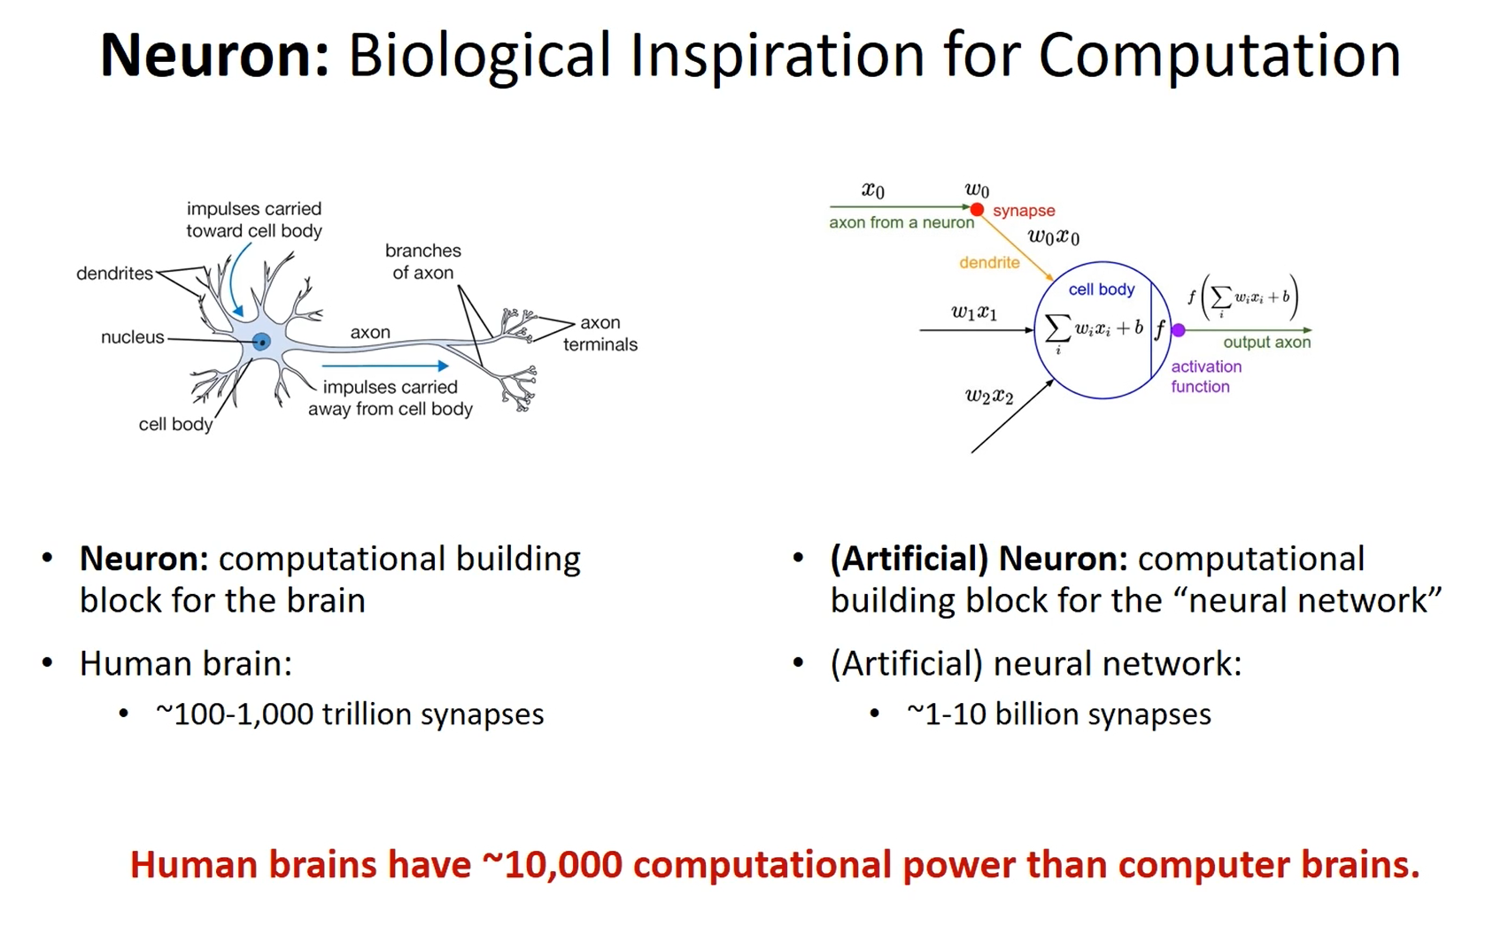

Slide 30
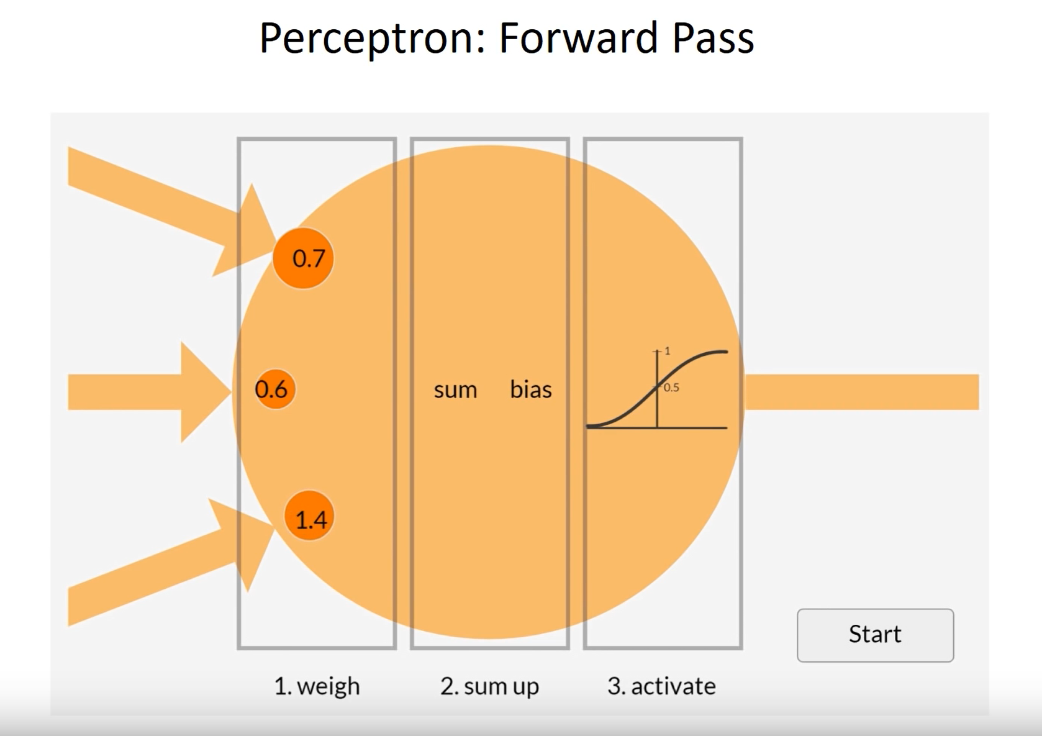
Notes:
Here is an example of an artificial neuron – a building block of a neural network

Slide 31
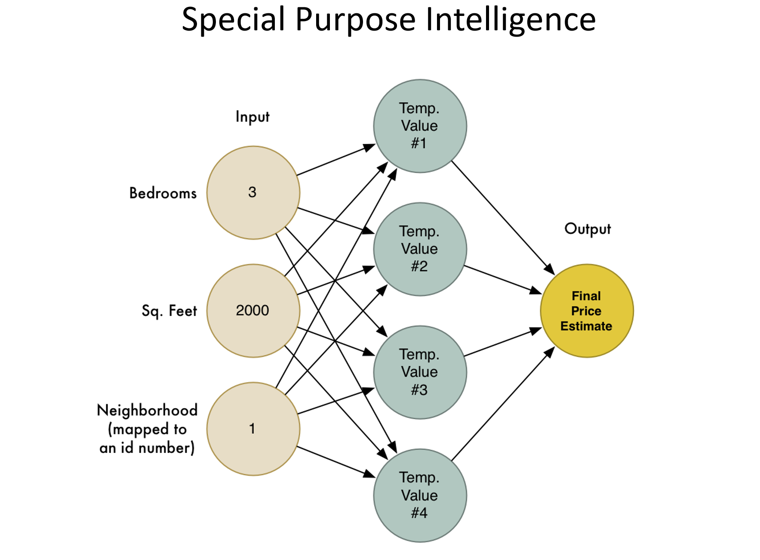

Slide 32
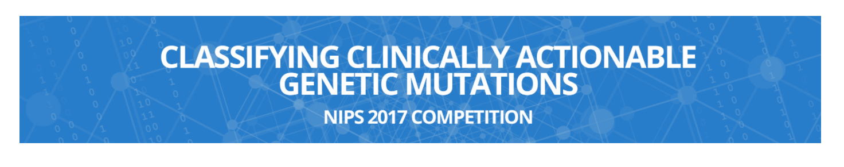
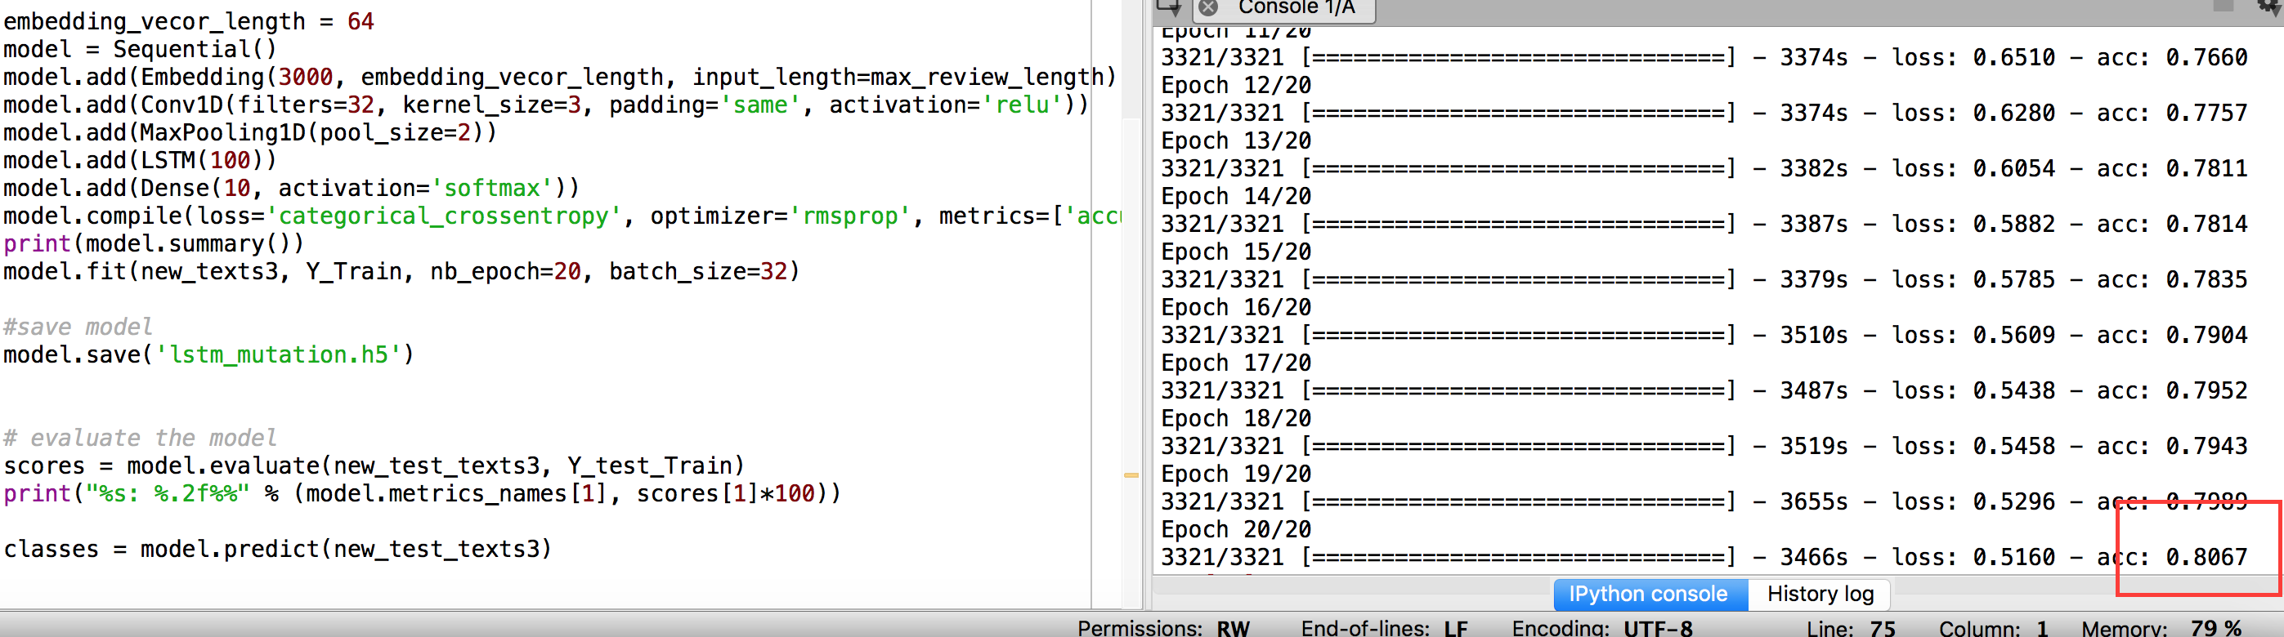

Slide 33
Intelligence
Information Management
Big Data Stores
Machine Learning and Analytics
Intelligence
Data Sources
Data Lake Store
Machine Learning
Cognitive Services
Data Factory
Bot Framework
SQL Data
Warehouse
Data Lake Analytics
Apps
Data Catalog
Cortana
Cosmos DB
HDInsight
(Hadoop and Spark)
Event Hubs
Sensors and devices
Stream Analytics
Data

Slide 34




Build applications that understand people
Intelligence
Vision
Speech
Language
Knowledge
Search
Cognitive Services
Computer Vision
Speaker Recognition
Text Analytics
Academic Knowledge
Bing Search API
Bot Framework
Face
Speech
Bing Speller
Entity Linking Service
Bing Image Search API
Cortana
Emotion
CRIS
Web Language Model
Knowledge Exploration Service
Bing Video Search API
Video
Linguistic Analysis
Recommendations
Bing News Search API
Language Understanding Intelligent Service
Bing Auto Suggest API
Faces, images, emotion recognition and video intelligence
Spoken language processing, speaker recognition, custom speech recognition
Natural language processing, sentiment and topics analysis, spelling errors
Complex tasks processing, knowledge exploration, intelligent recommendations
Bing engine capabilities for Web, Autosuggest, Image, Video and News

Slide 35
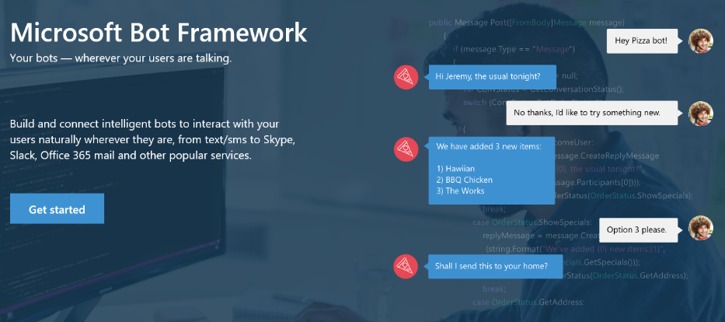
Your bots – wherever your users converse
Intelligence
Cognitive Services
Bot Framework
Cortana
Bot Connector Service: A service to register your bot, configure channels and publish to the Bot Directory. Connect your bot(s) seamlessly to text/sms, Office 365 mail, Skype, Slack, Twitter, and more.
Bot Builder SDK: An open source SDK hosted on GitHub. Everything you need to build great dialogs within your Node.js or C# bot
Bot Directory: A public directory of bots registered through the Bot Connector Service. Discover, try, and add bots to conversation experiences

Slide 36

Get things done in more helpful, proactive and natural ways
Here are some of the things I can help you with…
Cortana for Consumers (today)
With the Cortana Intelligence Suite
Intelligence
Cognitive Services
Answers
Public reference data answers – “How far is it from Los Angeles to San Francisco?”
Answers from organizational data in Power BI
“What were our biggest deals that closed last month?”
Bot Framework
Predictions
Event predictions – “Who do you think is going to win the Germany Italy game?”
Integration with prediction solutions
“Which of our customers are most likely to churn in the next quarter?”
Cortana
Monitoring & Alerts
Flight status, traffic conditions, changes in weather, …
Monitoring KPIs and preemptive alerting
“Alert me if this customer ever has a 90% chance of churn in the next 30 days”
Task Completion
Setting reminders, scheduling meetings, getting directions, …
Line of business process integration
Assistance with expense report submission on-time within policy

Slide 37
Dashboards & Visualizations
Information Management
Big Data Stores
Machine Learning and Analytics
Intelligence
Data Sources
Data Factory
Data Lake Store
Machine Learning
Cognitive Services
Data Catalog
SQL Data
Warehouse
Data Lake Analytics
Bot Framework
Apps
HDInsight
(Hadoop and Spark)
Event Hubs
Cosmos DB
Cortana
IOT Hubs
Dashboards & Visualizations
Sensors and devices
Stream Analytics
Power BI
Data
Data
Intelligence

Slide 38
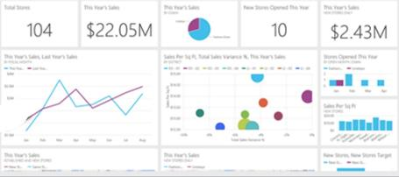
Keep a pulse on your business with live, interactive dashboards
Stream Analytics
Event Hubs
Power BI
Machine Learning
Storage
Power BI
Dashboards & Visualizations
SQL database
Power BI
HDInsight
Power BI
Analytics for everyone, even non-data experts
Your whole business on one dashboard
Create stunning, interactive reports
Drive consistent analysis across your organization
Embed visuals in your applications
Get real-time alerts when things change

Slide 39
Transform data into intelligent action
Information Management
Big Data Stores
Machine Learning and Analytics
Intelligence
People
Data Sources
Data Factory
Data Lake Store
Machine Learning
Cognitive Services
Data Catalog
SQL Data
Warehouse
Data Lake Analytics
Bot Framework
Web
Apps
Cosmos DB
HDInsight
(Hadoop and Spark)
Mobile
Event Hubs
Cortana
Apps
Bots
Sensors and devices
Stream Analytics
Dashboards & Visualizations
Automated Systems
Power BI
Data
Data
Intelligence
Action

Slide 40

© 2016 Microsoft Corporation. All rights reserved.

Slide 41
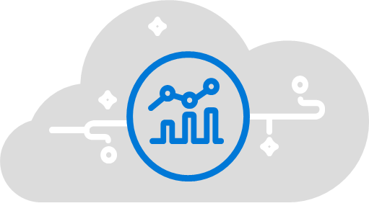

Operationalization Platforms
Solutions
Cortana Intelligence Suite
SQL Server 2016
Microsoft R
 | Intelligence | Cognitive Services, Bot Framework, Cortana
 | Dashboards and visualizations | Power BI | SSRS, DataZen, R | R visualizations
 | Machine learning and analytics | Machine learning, Stream Analytics, HDInsight | SSAS, SQL Server R Services | Microsoft R
 | Big data store | Data Lake, SQL, DW | OLTP, DW, Hadoop, EDSs | Hadoop, Teradata, Linux, Windows
 | Information management | Data Factory, Data Catalog, Event Hubs | SSIS, DQS, MDS | Spark SQL/ETL
Notes:
Cortana Analytics is a fully managed big data and advanced analytics suite that transforms your data into intelligent action.
It is a comprehensive suite that brings together technologies throughout Microsoft and provides fast and flexible deployment with a simple monthly subscription to reduce the time and cost.
With Cortana Analytics, we are taking years of research and innovation – spanning technology & infrastructure for advanced analytics, including capabilities such as machine learning, big data storage and processing in the cloud, perceptual intelligence e.g. vision, face and speech recognition and integration with Cortana, Microsoft’s personal digital assistant with the goal of helping enterprise customers make better, faster decisions to accelerate their speed of business.
Slide objective
.
Talking points
.
Notes

